Slide 1
CS501 Final Project Proposal
Lucy Schofield, Nora Bockert, Brandon Bouley

Slide 2
01
App Idea

Slide 3
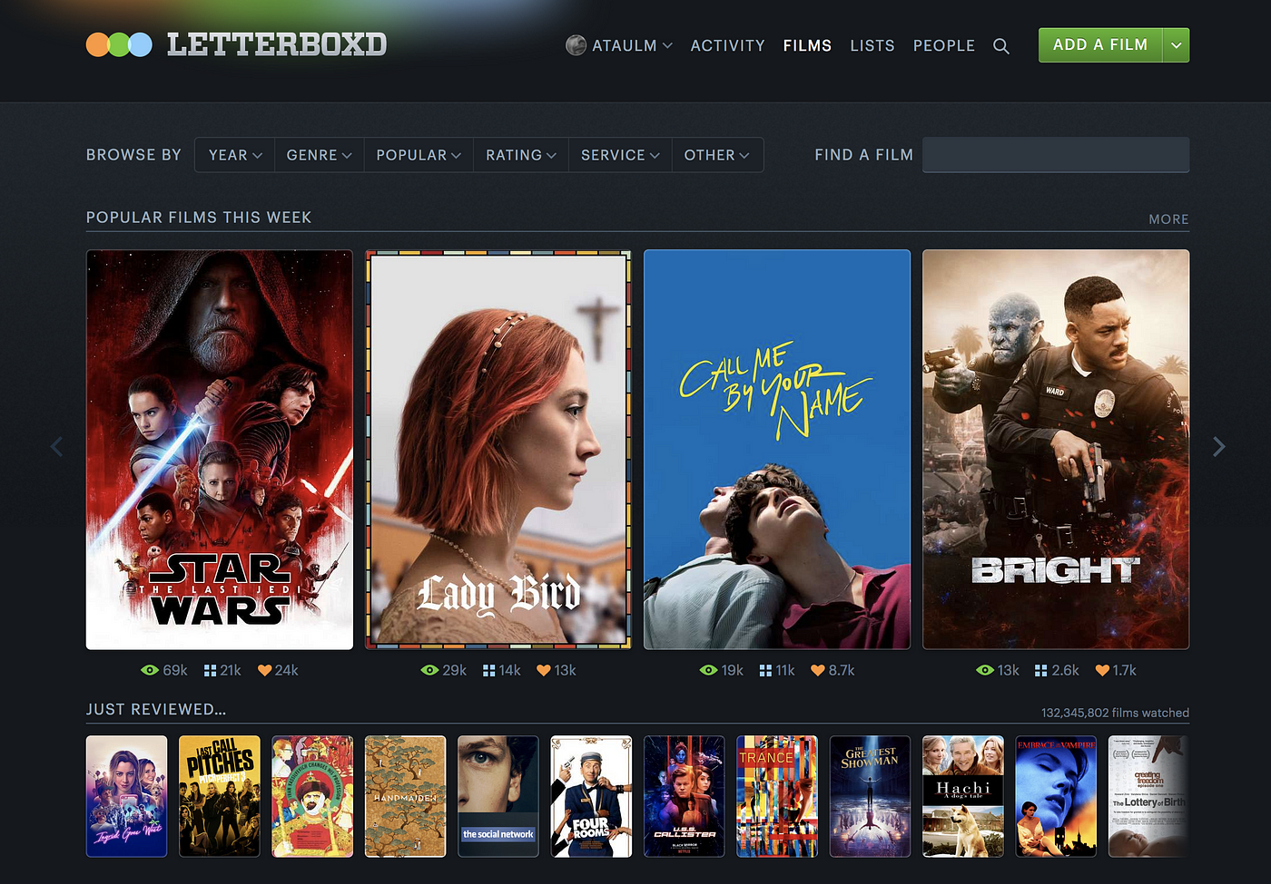
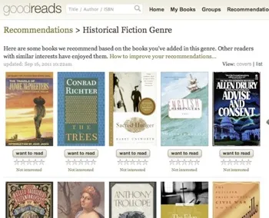
App Idea: PITCH
A music sharing and rating platform
Existing Apps with similar purpose/functionality:
Letterboxd
GoodReads

Slide 4
Motivations & Purpose
The Problem:
We noticed that there are some limitations for discovering music on the two most popular music streaming platforms (Apple Music and Spotify). In conversations online and with friends we found that the algorithms used to suggest new music to users often repeat the same songs a user already has in their library or will suggest something mainstream/popular despite the users unique listening profile.
The Motivation:
Our team are avid music listeners and enjoy sharing our music with friends. We wanted to create an app that would align with these interests.
Market Gap:
There is currently no music rating/sharing platform that is as popular as applications like Letterboxd and Goodreads
80
70
BAR GRAPH INFO 1
BAR GRAPH INFO 1
BAR GRAPH INFO 1
BAR GRAPH INFO 1

Slide 5
02
Components

Slide 6
App Components
What will we use to build our app?
APIs
Database
Spotify for Developers: Gives us a large pool of songs for users to search through
Google OAuth: Allows users to sign in and create an account through Google
PostgreSQL: open source database, allows us to store and update ratings/comments for each song in the DB
Sensors
Target Devices
Camera: Allows users to create a profile picture
GPS: access user’s location for friend suggestions
Accelerometer: Shake to review, shaking the phone will pick a random song from the DB to review
Mobile Phones & Tablet: Main home screens and navigation bar will simplify/expand based on the size and orientation of the device

Slide 7
03
How it works

Slide 8
Vision
A clean, simple, and easy to use layout with intuitive navigation.

Slide 9
Basic Functions:
Users log in (via OAuth)
Profile page will have room for a username, a profile picture, a bio, and an average rating
User can create a post: Search for a song on the search page, select a song, rate it out of 5 stars, leave a comment, and it will display on their profile
Other users ratings will be displayed below each song page
An explore feed tab is available for users to see other user’s reviews

Slide 10
Additional Functions (nice to haves)
User home pages will have a follower/ following count where users can look up friends to follow their recommendations on their explore page
A suggestion tab based on a users reviews: “Users who liked this song, also liked this song”
When a user creates a post, the app gives the user an option to share their review: the app will automatically format the review into a downloadable picture possibly linked to other social media apps (Instagram, Snapchat, X, etc)

Slide 11



Design Wireframes
pitch.
username
password
login
p.

Slide 12


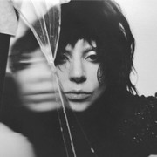
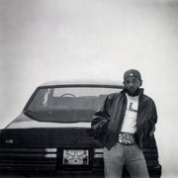
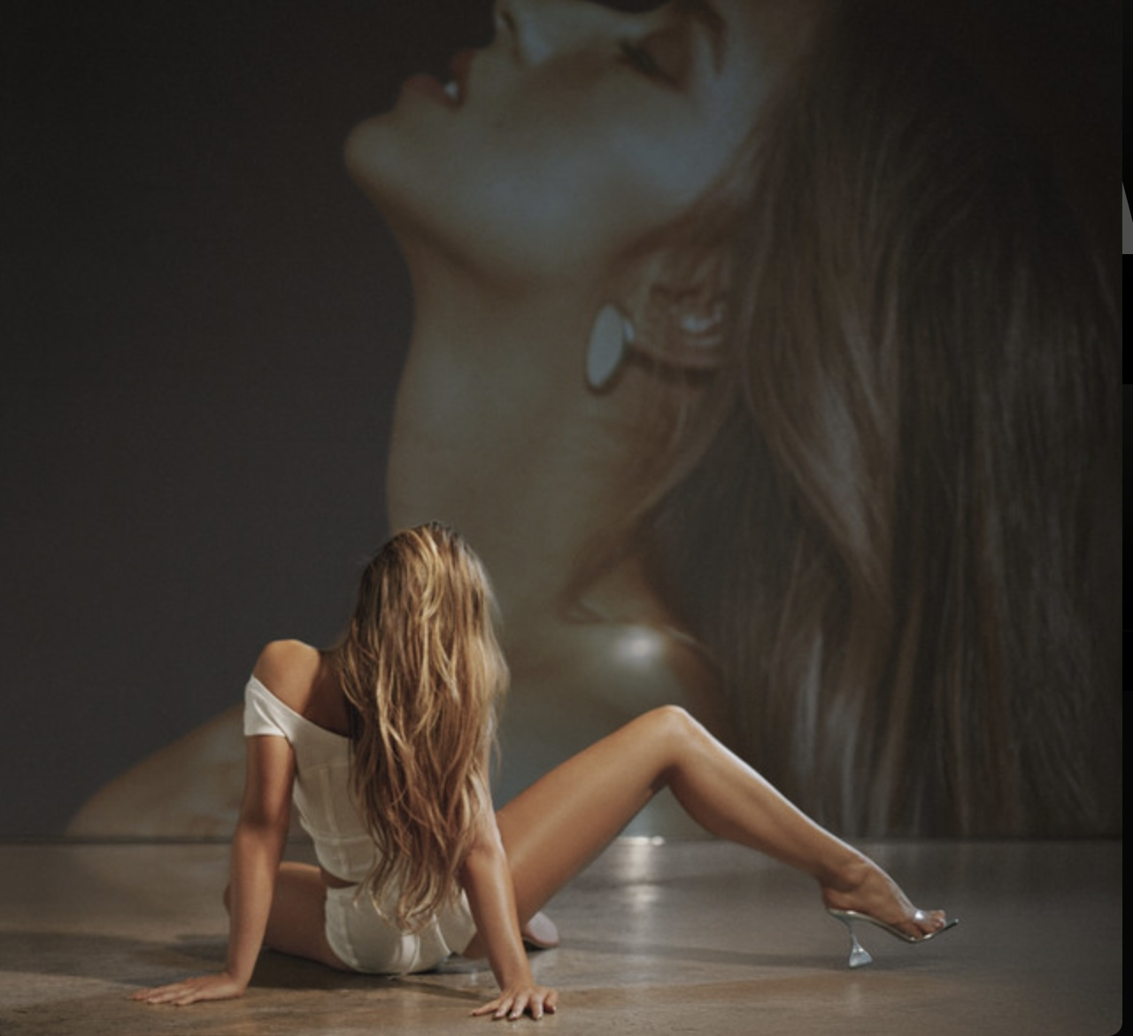




pitch.
trending albums
MUSIC
MAYHEM
GNX
trending songs
luther ft. SZA
Evil JOrdan
Sports car
reviews for you
swiftie4evr2003
The Tortured Poets Department
Taylor Swift
I LOVE TAYLOR SWIFT!!!
!!!!!!!!!!!!!!!!!!!!!!!!!!!!!!!
!!!!!!!!!!!!!!!!!!!!!!!!!!!!

Slide 13
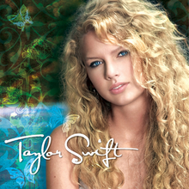
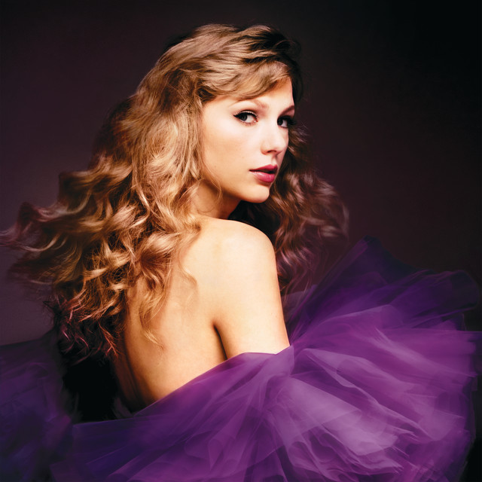

pitch.
swiftie4evr2003
Taylor Swift is everything to me. I’m a technology leader with 40 years’ experience progressing from developer to group leader to director…
add friend
favorite albums
recent reviews
swiftie 4evr 2003
The Tortured Poets Department
Taylor Swift
I LOVE TAYLOR SWIFT!!!
!!!!!!!!!!!!!!!!!!!!!!!!!!!!!!!
!!!!!!!!!!!!!!!!!!!!!!!!!!!!

Slide 14
THANK YOU

